Slide 1
INTRODUCTION TO MACHINE LEARNING AND REGRESSION BASICS

Slide 2
Trainer Guidelines for Conducting Class
Solve questions live by creating new blank files (Excel, Python, Jupyter notebook, Dashboard) during the session, rather than sharing completed solutions.
Review teaching materials and solutions beforehand, and prepare additional examples to reinforce learning.
Ensure online students can hear you and see the screen clearly at all times.
Test your computer and necessary software before class begins.
Check with online students every 15-20 minutes to see if they understand the material and have any questions.

Slide 3

Day 1: Agenda
Introduction to Machine Learning
Types of Machine Learning
Data Preprocessing
Handling Missing Values
Outlier Detection and Methods
Feature Scaling
Linear Regression as a Technique
Simple Linear Regression
Practical Example

Slide 4

.
Machine Learning Roadmap
Day | Module | Hours
Day 1 | Introduction To Machine Learning And Regression Basics | 3
Day 2 | Multiple Linear Regression & Model Evaluation | 3
Day 3 | Logistic Regression And Classification Metrics | 3
Day 4 | Decision Trees And Ensemble Methods | 3
Day 5 | Model Evaluation And Validation Techniques | 3
Day 6 | Unsupervised Learning | 3
Day 7 | Support Vector Machines (Svm) And K-nearest Neighbors (Knn) | 3
Day 8 | Time Series Modeling With Arima And Sarima | 3

Slide 5
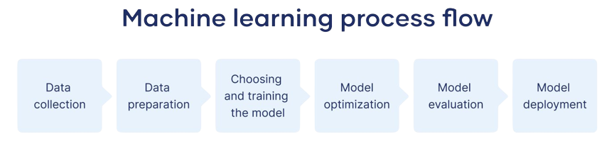
Introduction to ML
Machine Learning is a branch of artificial intelligence that involves the development of algorithms and statistical models, which enable computers to improve their performance on a specific task by learning from data and experience.
Machine Learning is like teaching computers to learn from examples and data so they can make decisions or predictions without being told exactly what to do
Significance in Data Analysis
Machine learning plays a pivotal role in data analysis.
Enables computers to make predictions and d

Slide 6
Role ML in Data Analysis
Empowering Data Analysis with Machine Learning
Machine learning revolutionizes data analysis by automating tasks, revealing insights, and predicting future trends.
Cross-Domain Applicability
In Healthcare: Enables diagnosis, treatment optimization, and patient outcome prediction.
In Finance: Enhances fraud detection, refines investment strategies, and assesses risk.
Driving Data-Driven Decisions
In the age of big data, machine learning empowers organizations to make informed, data-driven decisions for a competitive edge.

Slide 7
Types of Machine Learning
Supervised Learning
Utilizes labeled data for training.
Makes predictions based on patterns in labeled examples.
Common in tasks like classification and regression.
Unsupervised Learning
Deals with unlabeled data.
Identifies hidden patterns and structures within the data.
Useful for clustering and dimensionality reduction.
Reinforcement Learning
Learning through interactions with an environment.
Receives rewards or penalties based on actions taken.
Applied in autonomous systems and game playing.

Slide 8
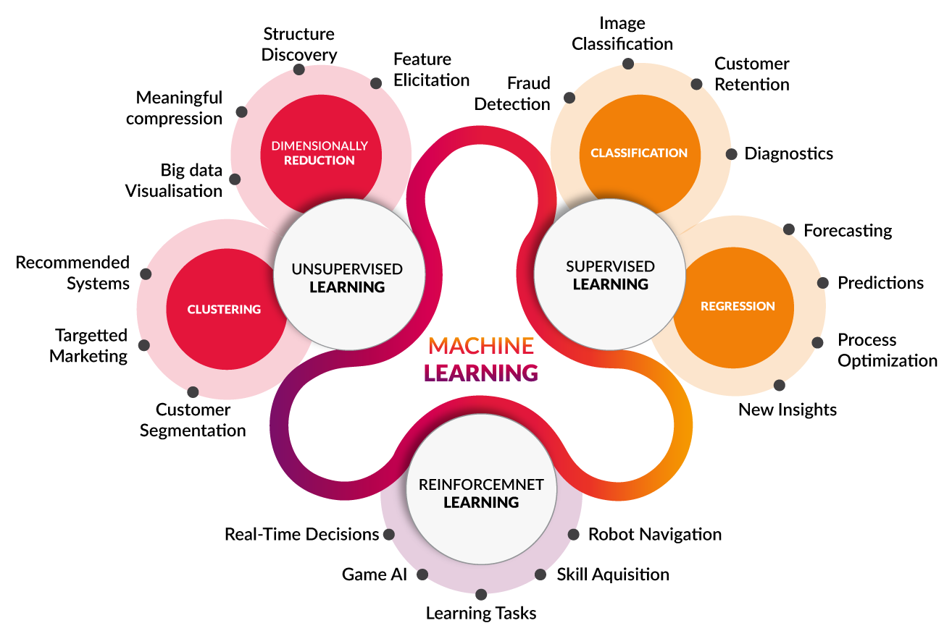
Types of Machine Learning

Slide 9
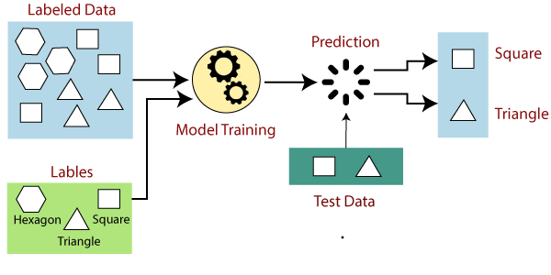
Supervised Learning
Definition of Supervised Learning
Involves labeled examples for training.
Model learns to predict labels for new, unseen data.
Clear Target Variable
Often used when you have a well-defined target variable.
Example: Predicting house prices based on features like size, location, and number of bedrooms.
Common Applications
Classification: Assigning categories (e.g., spam or not spam).
Regression: Predicting numeric values (e.g., stock prices).

Slide 10
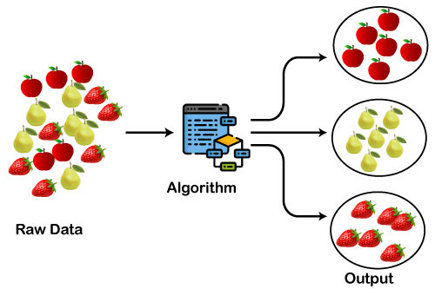
Unsupervised Learning
Defining Unsupervised Learning
It operates on unlabeled data, without specific target outcomes.
The goal is to discover patterns or structures within the data.
No Target Labels
Unlike supervised learning, there are no predefined target labels.
The algorithm seeks to identify inherent data relationships.
Common Use Cases
Clustering: Grouping similar data points together.
Dimensionality Reduction: Simplifying data while preserving key features.

Slide 11
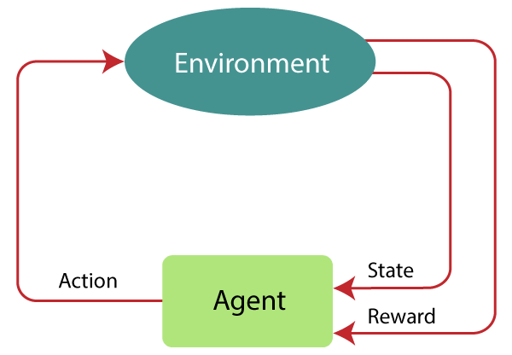
Reinforcement Learning
Exploring Reinforcement Learning
It involves learning through interaction with an environment.
Agents take actions to maximize cumulative rewards.
Reward-Based Learning
Agents receive rewards or penalties based on their actions.
Learn optimal strategies to maximize cumulative rewards over time.
Applications
Autonomous Systems: Self-driving cars, robotics.
Game Playing: Achieving superhuman performance in games.

Slide 12
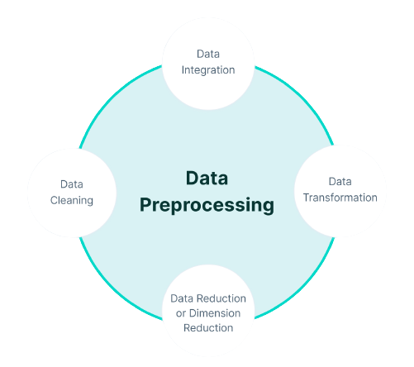
Data Preprocessing
Data Preprocessing It involves cleaning, transforming, and organizing raw data into a format that is suitable for analysis or for training machine learning models.
Importance of Data Preprocessing:
Data quality improvement
Feature engineering
Scaling and normalization
Handling missing values
Outlier detection and treatment
Categorical data encoding
Dimensionality reduction
Data splitting for evaluation

Slide 13
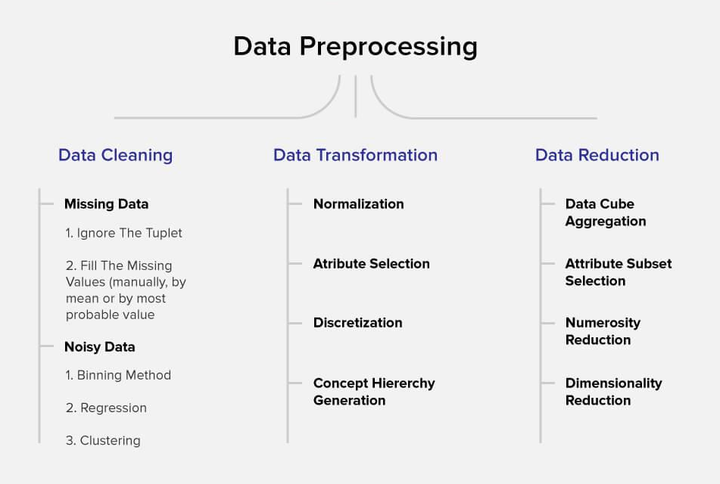
Steps in Data Preprocessing
Data Collection
Data Cleaning
Handle missing values
Remove duplicates
Correct errors
Exploratory Data Analysis (EDA)
Feature Engineering
Data Encoding
Categorical variables to numerical
Ordinal variables (if needed)
Normalization and Scaling
Dimensionality Reduction (if needed)
Data Splitting (train, validation, test)
Data Transformation (if required)

Slide 14
Steps in Data Preprocessing
Data Collection: Gather the raw data from various sources, such as databases, files, or web scraping.
Data Cleaning: Clean the data by handling missing values, removing duplicate records, and correcting any noticeable errors.
Handle Missing Values: Address any missing values in the dataset by either imputing values or removing incomplete records.
Remove Duplicates: Identify and remove duplicate entries from the dataset to ensure data integrity.
Correct Errors: If any noticeable errors or inconsistencies are present, correct them to improve data quality.
Exploratory Data Analysis (EDA): Understand the data through visualizations and summary statistics to gain insights and identify patterns.

Slide 15
Steps in Data Preprocessing
Feature Engineering: Create new features or transform existing ones to better represent the underlying data patterns.
Data Encoding: Convert categorical variables into a numerical format, such as one-hot encoding for nominal variables and ordinal encoding for ordinal variables (if applicable).
Normalization and Scaling: Scale numerical features to a similar range to ensure that no single feature dominates the others.
Dimensionality Reduction (if needed): Reduce the number of features while preserving important information using techniques like Principal Component Analysis (PCA).
Data Splitting (train, validation, test): Split the dataset into training, validation, and test sets for model evaluation and prevention of data leakage.
Data Transformation (if required): Apply additional transformations to the data as needed for specific analysis or modeling requirements.

Slide 16
Hands-on: Data Preprocessing
Perform a data preprocessing on housing dataset.

Slide 17
Feature Scaling
Feature scaling is a crucial data preprocessing technique in machine learning. It involves adjusting the range of independent variables or features in your dataset to make them more compatible with various machine learning algorithms. This adjustment is necessary because different features often have different scales, and some algorithms are sensitive to these scale differences.
Feature scaling typically involves two common methods:
Normalization
In this method, you scale the features to a specific range, typically between 0 and 1
Standardization
This method transforms the features to have a mean of 0 and a standard deviation of 1

Slide 18
Supervised Learning
Regression
Classification

Slide 19
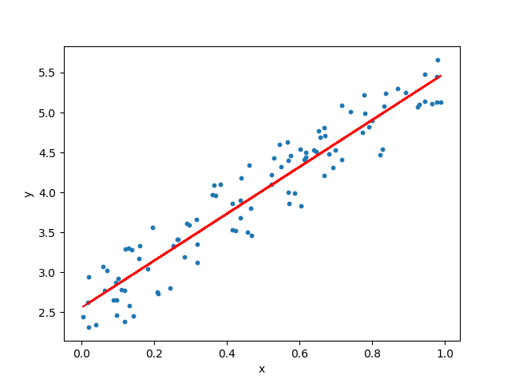
Linear Regression as Regression Technique
Introduction to Linear Regression
Linear regression is a widely used regression technique.
It's employed for predicting a continuous target variable.
Assumption: Assumes a linear relationship between input features and the target.
Linear Relationship
Linear regression models aim to find the best-fitting straight line.
The line represents the relationship between inputs and the target variable.
Common Applications​
Predicting house prices based on features like square footage and number of bedrooms.​
Estimating sales based on advertising spend.

Slide 20
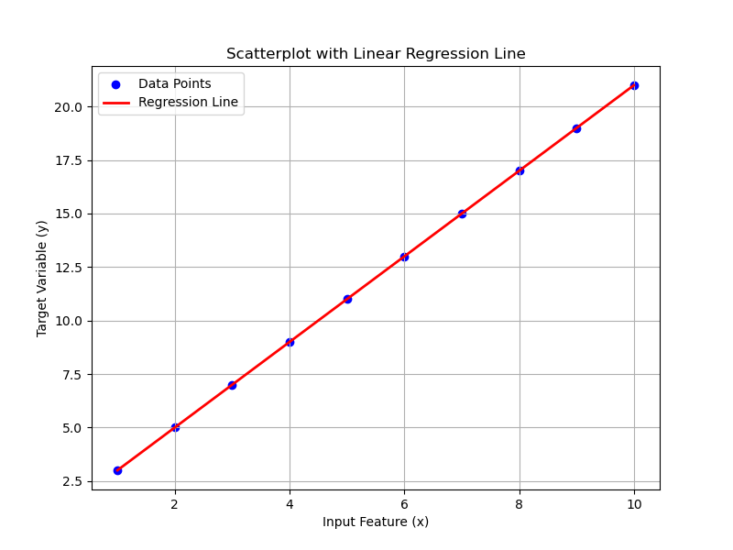
Simple Linear Regression
The relationship is expressed by the equation: y = mx + b.
y: Target variable (what we want to predict).
x: Feature or input variable (what we use to make predictions).
m: Slope of the line (represents the relationship's steepness).
b: Intercept (the point where the line intersects the y-axis).
Simple Linear Regression is a basic form of regression analysis.​
It involves one input variable (feature) and one output variable (target).

Slide 21
Predicting Ice Cream Sales
Independent Variable: Temperature
The independent variable, in this case, is "Temperature."
Dependent Variable: Ice Cream Sales
The dependent variable is "Ice Cream Sales."
Hypothesis: You hypothesize that there's a positive relationship between temperature and ice cream sales. That means as the temperature increases, you expect ice cream sales to increase
Data Collection: You collect data on daily temperatures (in degrees Fahrenheit) and daily ice cream sales (in dollars) for a period.
Analysis: Using this data, you can perform a simple linear regression analysis:
Independent Variable (X): Temperature
Dependent Variable (Y): Ice Cream Sales
You'll build a linear regression model to predict ice cream sales based on temperature.

Slide 22
Linear Regression Steps
Data Collection: Gather input features and target variable.
Data Preprocessing: Handle missing data, outliers, and scaling.
Data Splitting: Divide into training and testing sets.
Model Selection: Choose a regression technique (e.g., linear).
Model Training: Fit the model to the training data.
Model Evaluation: Assess performance using metrics (MSE, R2).
Model Interpretation: Analyze feature importance.
Prediction: Use the model for new data.

Slide 23
Question
Provide a step-by-step explanation of how to create a simple linear regression model to housing prizes using housing data. Include instructions on generating synthetic data for this example and clarify the significance of the slope and intercept in interpreting the model's predictions
Notes:
Note: Use – Jupyter File for this example - Linear Regression - Student Performance.ipynb

Slide 24
Questions ?

Slide 25
Thank You !

